Slide 1


Slide 2
Pediatric is a branch of medicine that deals with care of children and adolescent
Derived from two Greek words
Pedo pais- child
Latros- healer

Slide 3
Is the only discipline dedicated to all aspects of the care and wellbeing of infants, children, and adolescents, including their health—their physical, mental, social, and psychological growth and development
Their ability to achieve full potential as adults.

Slide 4
More than 90% of the world’s children are born in developing countries
35,000 die each day, mostly of common and preventable problems
Health and illness are a result of a complex dynamics of environmental, social, political and economic factors

Slide 5
Principles of child health in developing countries
UNICEF, WHO, and developed countries argued for more selective programmes whose outcomes and cost can be readily measured
Selective strategies for the child survival revolution that were implemented were:
(GOBI-FFF)
Growth monitoring
Oral rehydration
Breast feeding

Slide 6
Principles….
Immunization
Food
Female education, and
Family planning
GOBI-FFF has remained the developed world’s primary strategy for health development.

Slide 7
Child Health In Ethiopia

Slide 8
Introduction
Child health is a state of physical ,mental ,intellectual, social and emotional well-being and not merely the absence of disease or infirmity. /WHO/
Healthy children live in families,environments,and communities that provide them with the opportunity to reach their fullest developmental potential.
Children cannot achieve optimal health alone.

Slide 9
Organized institutional child health care was introduced in Ethiopia in 1957 when the former Ethio-Swedish Pediatric Clinic was opened by Prof. Edgar Mannheimer within premises of the former Princess Tsehai Memorial Hospital.
In 1965 with the establishment of the faculty of medicine it accommodated the department of pediatrics consisting of 100 beds inpatient service.

Slide 10
Child health situation
children under age five die mostly from preventable
diseases.
In sub-Saharan Africa, one in nine children die before age of five, more than 16 times the average for developed region

Slide 11
Major proximate determinants of infant and under-five mortality.
• Mother’s Characteristics: mother’s literacy status, health service utilization (ANC), age at birth, exposure to mass media and total number of births.
• Child’s Characteristics: Birth interval, sex of the child, and total number of sibling births;
• Household Characteristics: Household wealth, residence, availability of safe drinking water, and improved toilet facility.

Slide 12
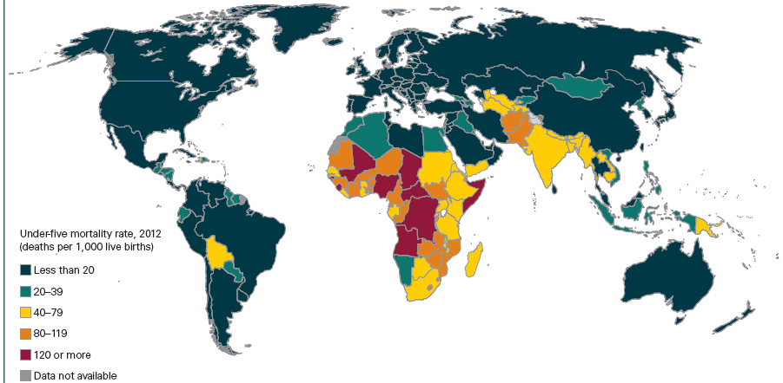
Under five mortality rate

Slide 13
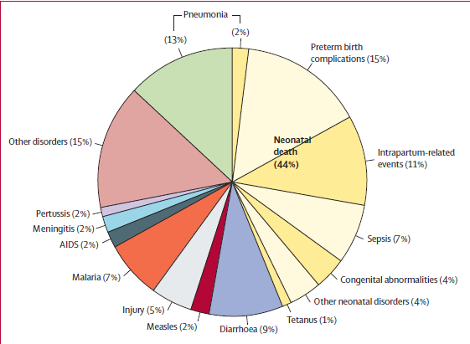
Global Causes of child deaths Li Liu et al.. lancet 2015

Slide 14
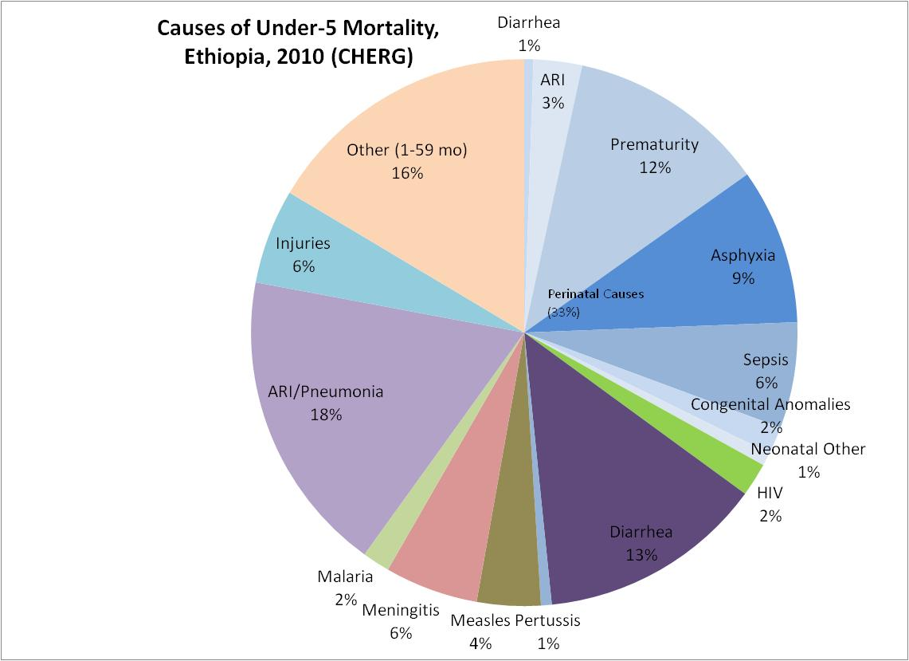
Causes of Child Mortality: Ethiopia
Perinatal causes contribute for 33% of child deaths. ARI/Pneumonia (18%), Diarrhea (13) and Meningitis (6%) are major causes of death children.

Slide 15
Estimated Causes of Neonatal Deaths in Ethiopia
Source: Liu L. et al. 2012. Global, regional, and national causes of child mortality in 2000–2010: an updated systematic analysis. The Lancet. doi:10.1016/S0140-6736(12)60560-1.)
Three causes (preterm complications, intrapartum related, & severe infection) account for 89% of all newborn deaths
Notes:
This graph is based on a systematic analysis of data from 2000-2010. As can be seen, the three main causes of neonatal mortality accounting for about 90% of deaths are preterm birth, intrapartum causes and infections .
In the first half of 2000, infections accounted for 44% of newborn death in the country.
Another underlying factor for high neonatal mortality is low birth weight. According to the 2011 EDHS, an estimated 11% of newborns are low birth weight though this figure may underestimate the extent of the problem as most newborns are not weighed at birth due to low institutional delivery coverage [only 5% of newborns are weighed at birth].

Slide 16
Child health care interventions
1
2
3
4
Health child

Slide 17
Newborn care interventions.
access to skilled care during pregnancy, childbirth and the immediate postnatal period at community and facility level.
early and exclusive breastfeeding
warmth
hygienic cord and skin care
timely and appropriate care-seeking for infections
care of low-birth-weight infants.

Slide 18
Components of Community Based Newborn Care Package
Early Identification of Pregnancy
Provision of Focused Antenatal Care (ANC)
Promotion of institutional delivery and
Safe and clean delivery including provision of misoprostol in case of home deliveries or deliveries at health post level
Provision of immediate newborn care, including application of Chlorohexidine on cord

Slide 19
Cont’d
Recognition of asphyxia, initial stimulation and resuscitation of newborn baby
Prevention and management of hypothermia
Management of pre-term and/or low birth weight neonates
Management of neonatal sepsis/very severe disease at community level

Slide 20
Key interventions
Pneumonia
Exclusive breast feeding
Adequate complementary feeding
Hib and pneumo vaccination
Measles vaccination
PMTCT
Vitamin A supplementation
Antibiotic treatment

Slide 21
Diarrhoea
Hygiene/sanitation/ safe water
Exclusive breast feeding
Adequate complimentary feeding
Vitamnin A supplementation
ORS
Zinc supplement
Antibiotic

Slide 22
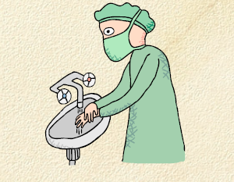
Water, sanitation, and hygiene interventions
Risk reductions for diarrhea of:
48% with hand washing with soap
17% with improved water quality
36% with excreta disposal

Slide 23
Malnutrition key interventions
Breast feeding
Complementary feeding
Nutrition advice and supplementation
Vitamin A supplementation
deworming
Family planning
Management of severe acute malnutrition
Zinc

Slide 24
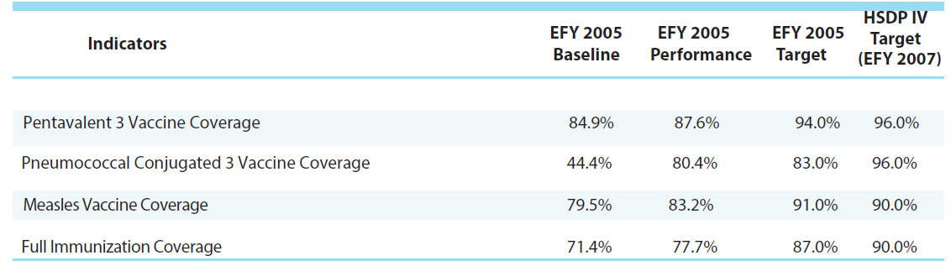
Immunization coverage

Slide 25
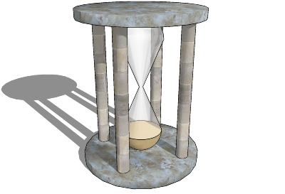
EPI schedule
time | vaccines
Birth | OPV0, BCG
6 weeks | OPV1, DPT1,Pneumovacc1. rota 1
10 weeks | OPV2, DPT2, pneumovacc2, rota 2
14 weeks | OPV3, DPT3, Pneumovacc3
9 months | Measles

Slide 26
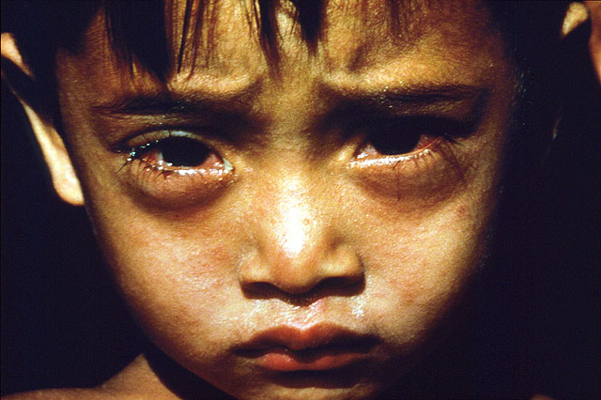
Measles interventions
Case detection
Vitamin A
Immunization

Slide 27
HIV key interventions
Family centred care
Prevention of HIV infection
Care of HIV exposed infant
Care and treatment of HIV infected child
ART
Treating opportunistic infections

Slide 28
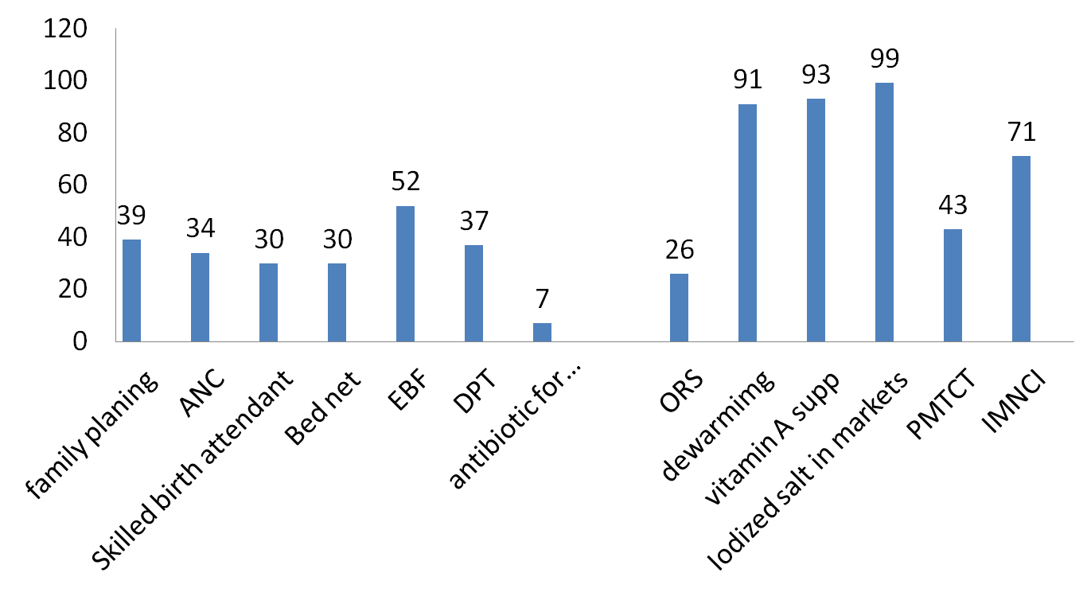
Child health interventions
Notes:
Interventions that have narrow delivery channel and separate management, such as immunization, achieve high coverage, whereas those that require fuctional health system and facilities such as sklled attendance and postnatal care reach barely half the population in need.

Slide 29


Challenges
New emerging diseases
Adolescent health
Regional health status disparity
Sustainability of maintaining the achievements
Actions beyond survival
High impact interventions are incomplete
Low pediatric hospital coverage
Shortage of skilled manpower

Slide 30
Summary
child survival improved due to effective public health Interventions and better economic and social performance.
The majority of under-five deaths are due to a small number of common, preventable and treatable conditions.
Affordable interventions exist which could prevent 63% of mortality.

Slide 31
GROWTH & DEVELOPMENT

Slide 32
Growth:
Change in size due to change in cell size &/or number
Quantitative(Kgs, Centimeters)
Development:
Functional maturation
mainly depends on the maturation & myelination of the NS.
Assessed by skill acquisition

Slide 33
Principles of growth & development
Growth and development are continuous dynamic processes occurring from conception to maturity.
The sequence of development is the same in all children, but the rate of development varies from child to child.

Slide 34
Cont’d
Development is intimately related to maturation of the nervous system, but may be profoundly modified by environment & experience.
Development is in the cephalocaudal direction. The first step towards walking is the development of head control. The infant can do much with his hands before he can walk.

Slide 35
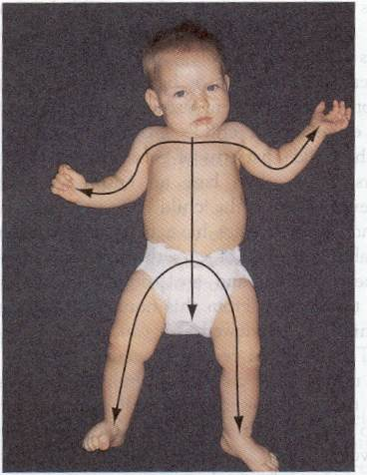
Growth Pattern

Slide 36
Factors affecting growth & development
Heredity
Pre and postnatal environment
Sex
Endocrine system
Disease and
Nutrition

Slide 37
Why developmental assessment?
Early detection of deviation in child’s pattern of development
Simple and time efficient mechanism to ensure adequate surveillance of developmental progress
Deviations in growth patterns are important indicators of serious and chronic medical disorders

Slide 38
FETAL GROWTH & DEVELOPMENT
Embryonic period
- the 1st 8 weeks of the prenatal period.
- the 1st week is germinal; its chief feature is cellular division and the formation of blastocyst.
- during the 2nd week, the cell mass differentiates in to two layers (endoderm & ectoderm); during the 3rd week mesoderm is added.

Slide 39
Cont’d
- during the 4th week, the growing organism elaborates the somities and undergoes rapid differentiation between the fourth and eighth week in to an essential human form.

Slide 40
Fetal period
- is the period from nine weeks on.
- is marked by rapid growth and elaboration of function.
- by 12 weeks the gender of the external genitalia becomes clearly distinguishable.
- 2nd trimester – rapid acquisition of new functions.
- 3rd trimester – increase in subcutaneous tissue.

Slide 41
Stages of Growth and Development
Infancy
Neonate
Birth to 1 month
Infancy
1 month to 1 year
Early Childhood
Toddler
1-3 years
Preschool
3-6 years
Middle Childhood
School age
6 to 12 years
Late Childhood
Adolescent
13 years to approximately 18 years

Slide 42
INFANCY
Physical Growth
- the average newborn weighs ~3.25 kg at birth.
- in the first few days of life newborns may loose up to 10% of their birth wt. This is attributable to excretion of excess extra vascular fluid and less intake.
- most term infants regain their birth wt by ten days of age and grow at ~30g/d in the 1st month of life.

Slide 43
Cont’d
- between 3 and 4 months the rate of growth slows to ~20g/d.
- the full term infant generally doubles birth wt by five months and triples by one year.
- the anterior fontanel is closed between 9 and 18 months and the posterior by 4 mo.
- head circumference ( 34-35 cm at birth) increases to ~44 cm by 6 mo & to 47 cm by one year.

Slide 44
Infant
1. Physical growth
Weight:- Double at 5th month, triple at 11-12th month
3-12m = age(m)+9
2
Length:-Increase by 25 cm in the 1st yr, 12.5 cm in the 2nd yr.
Brain growth:- HC increase by 12 cm in the first yr,
- only 2 cm in the 2nd year.

Slide 45
- the first deciduous teeth erupt between 5 and 9 mo.
Formula for ~ average Ht and Wt of normal infants and children
Age Wt (kg)
3 – 12 mo age (mo) + 9 / 2
1 – 6 yr (age (yr) + 4)2
7 – 12 yr age (yr) * 7 – 5 / 2

Slide 46
Cont’d
Age Ht (cm)
at birth 50
1 yr 75
2 – 12 yr age (yr) * 6 + 77

Slide 47
Neurodevelopment
- 4– 8 weeks – head lags when pulled to sitting position, head control is absent in upright position.
- 12 weeks – some control of the head as infant is drown to a sitting position, head tilted a little forward on the upright body.

Slide 48
cont’d
- 4 months – no head lag on pull to a sitting position, head tilts a little forward but is held steady on the upright body.
- 5-6 months – head can be maintained erect, rolls over.
- 6-6 ½ months – grasps large objects and transfers it from hand to hand, sits alone leaning forward on hands with slight support of the pelvis.

Slide 49
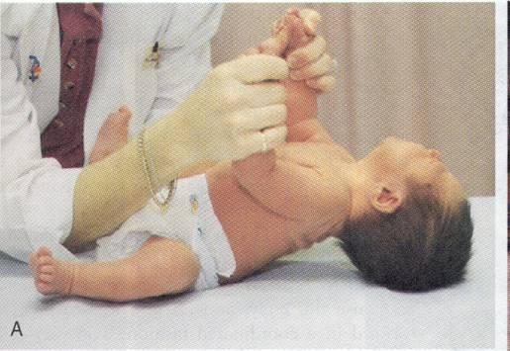
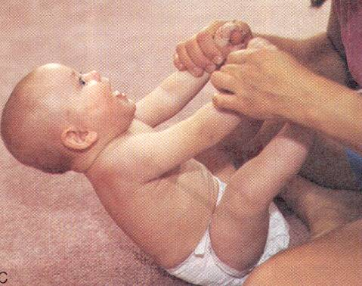
Head Control
Newborn
Age 6 months
Notes:
Newborn

Slide 50
.
- 8-9 months – sits with out support
9-10 months- creeps or crawls, pincer grasp.
- 1 year – walks on one hand held.

Slide 51
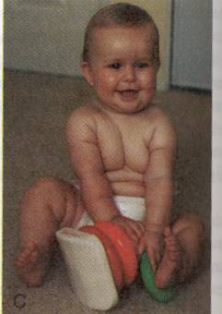
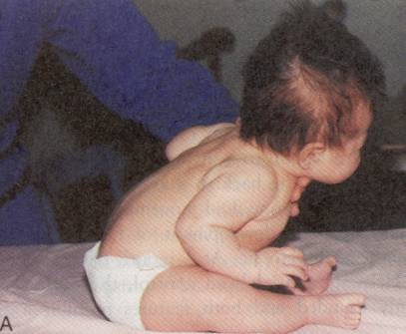
Sitting Up
Age 2 months
Age 8 months

Slide 52
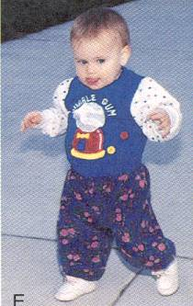
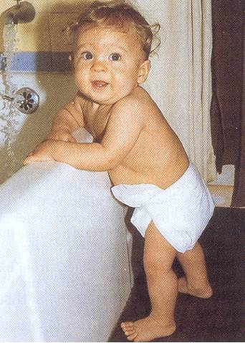
Ambulation
13 month old
Nine to 12-months
Notes:
N

Slide 53
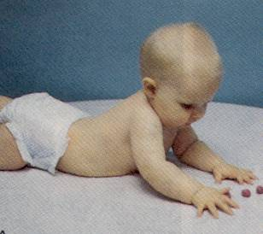
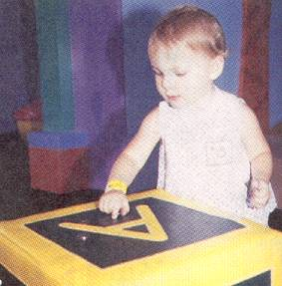
Fine Motor Development
6-month-old
12-month-old

Slide 54
Psychosocial development
- 3-5 weeks – social smile
- 4 months – laughs aloud
- 7 months – responds to changes in facial expression.

Slide 55
Cont’d
The most important psychological milestone during infancy is the development of trust.
Language
1-2 months: coos
2-6 months: laughs and squeals
8-9 months babbles: mama/dada as sounds non-specifically
10-12 months: “mama/dada specific
by one year of age – can call 2 or 3 words with meaning

Slide 56
Red Flags in infant development
Unable to sit alone by age 9 months
Unable to transfer objects from hand to hand by age 1 year
Abnormal pincer grip or grasp by age 15 months
Unable to walk alone by 18 months
Failure to speak recognizable words by 2 years.

Slide 57
Toddler hood
the growth rate slows in the 2nd yr of life & appetite declines.
Most children begin to walk independently near their 1st birthday.
At first infants toddle with a wide based gait, knees bent and arms flexed at the elbow; the entire torso rotates with each stride
Brain growth continues to decelerate during the 2nd yr. Head circumference, which increased ~12 cm during the 1st year, increase only 2 cm during the 2nd year.

Slide 58
Cont’d
- By the end of the 1st yr, the brain has reached ~ two third, and by the end of the 2nd yr, four fifth of its adult size.
- A two yr old child is able to imitate circular strokes, make a horizontal line and put three words together.
The most important psychosocial achievement of toddlers is the development of autonomy or independence.

Slide 59
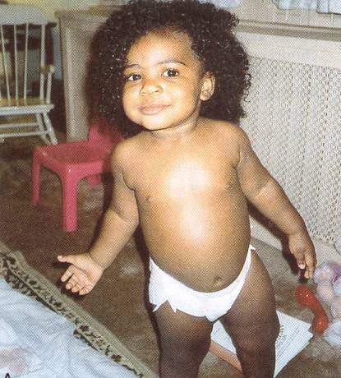
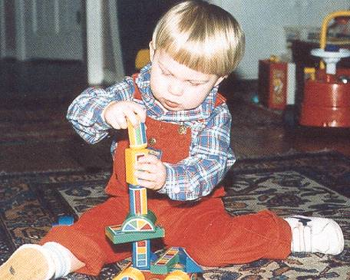
Toddler
Adele Piliterri, Child Health Nursing, Lippincott

Slide 60
Preschooler (3-6 years)
During this period of life gain in weight and height are relatively steady at ~ 2kg and 6-8cm per year respectively.
- By 3 yrs of age all twenty primary teeth have erupted.
- Bowel and bladder control emerges during this period, average 30 mo of age.

Slide 61
Cont’d
- 3 yrs – goes upstairs with alternating feet.
- stands momentarily with one foot.
- copies a circle and imitates a cross.
- knows age & sex.
- constructs short sentences.
- can ride a tricycle, feeds self well.
-4 yrs – goes downstairs with alternating feet
-copies cross and square, tells a story

Slide 62
Cont’d
- 5 yrs – hops on one foot, skips
- draws a triangle from a copy
- dresses and undresses
- knows four colors.
The developmental task of a preschooler is achieving initiative, which is the basis for future sense of ambition and purpose.

Slide 63
Red flags: preschool
Inability to perform self-care tasks, hand washing simple dressing, daytime toileting
Lack of socialization
Unable to play with other children

Slide 64
Early school years (6-12 years)
A period of relatively steady growth.
The head grows only 2-3 cm in circumference throughout the period.
Lymphatic tissues are at the peak of their development and generally exceed the amount of such tissue in the normal adult.
ambition and self worth are the most important developing values.

Slide 65
School Years: fine motor
Writing skills improve
Fine motor is refined
Fine motor with more focus
Building: models – legos
Musical instrument
Painting
Typing skills

Slide 66
School Age: gross motor
8 to 10 years: team sports
Age ten: match sport to the physical and emotional development

Slide 67
School Age: cognitive
Greater ability to concentrate and participate in self-initiating quiet activities that challenge cognitive skills, such as reading, playing computer and board games.

Slide 68
School performance
Ask about favorite subject
How they are doing in school
Do they like school
By parent report: any learning difficulties, attention problems, homework

Slide 69
Red flags: school age
School failure
Lack of friends
Social isolation
Aggressive behavior: fights, fire setting, animal abuse

Slide 70
Adolescence
Between the age of 10 and 20 yrs, children undergo rapid changes in body size, shape, physiology, psychologic, and social functioning.
The most important organizing process is the development of sexual maturity. Adolescence proceeds across three distinct periods –early, middle, & late- in terms of stages of pubertal development.

Slide 71
Early adolescence
Refers to the first stage of puberty (SMR2)
Age ranges from 10-13 yrs
In girls the 1st visible sign of puberty is the appearance of breast buds, between 8 &13 yrs and in boys, testicular enlargement begins as early as 9.5 yrs
For both sexes, growth acceleration begin in early adolescence, but peak growth velocities are not reached until SMR 3 or 4

Slide 72
Assessment of growth & development
Growth Chart
Growth chart is the most powerful tool in growth assessment.
Z score
The data are presented in4 standard charts:
1. weight for age (WFH)
2. height for age (HFA)
3. head circumference for age and
4. weight for height (WFH)

Slide 73
Dental development
Dental development includes mineralization, eruption, and exfoliation.
Initial mineralization begins as early as the 2nd trimester and continues thru age 3 yr for primary teeth and age 25 yr for permanent teeth.

Slide 74
Rule of ‘’4’’ = No teeth at 4 month of age, & 4 teeth will erupt approximately every 4 months there after until the child has 20 teeth.
Delayed eruption is usually considered when there are no teeth by ~ 13 mo of age

Slide 75
Cont’d
Common causes of delayed eruption include hypothyroidism, hypoparathyroidism, familial & idiopathic.
Nutritional disorders, prolonged illness, and use of certain drugs (tetracycline) in infancy or childhood may interfere with the calcification of deciduous and permanent teeth.

Slide 76
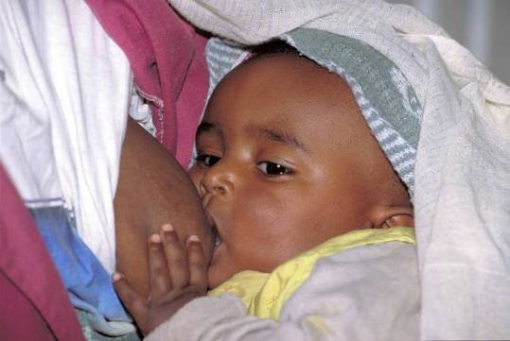
Thank You

